Slide 1

NETWORK PORT SCANNER
KOTHURI SHIVA KUMAR
AICTE ID :STU683ecb06dcc261748945670

Slide 2

Problem Statement
In modern computer networks, identifying open and vulnerable ports is essential for maintaining security, yet many systems lack simple and effective tools for continuous monitoring. Unauthorized open ports can expose critical services to cyber threats such as hacking, malware, and data breaches. The challenge is to develop a network port scanner that can efficiently detect open, closed, and filtered ports across devices, provide accurate and timely results, and present the information in a user-friendly manner. This tool should help system administrators identify potential vulnerabilities, improve network security, and ensure proper configuration of services while minimizing false positives and scan time.

Slide 3
Project Description
A network port scanner is a cybersecurity tool used to probe a computer or network device to identify which ports are open, closed, or filtered, helping determine what services are running and potentially accessible. By sending packets to specific port numbers and analyzing the responses, a port scanner can map the network’s exposure and detect vulnerabilities that attackers might exploit. System administrators and security professionals commonly use port scanners for auditing, troubleshooting, and strengthening defenses, while malicious actors may also use them to find entry points. Popular tools like Nmap automate this process and provide detailed insights into network configurations, making port scanning an essential practice in both offensive and defensive security.

Slide 4

WHO ARE THE END USERS?
The end users of a network port scanner include system administrators, network engineers, cybersecurity professionals, and ethical hackers, who use it to monitor, manage, and secure networks. Additionally, IT support teams and organizations use port scanners to identify vulnerabilities, troubleshoot connectivity issues, and ensure proper network configuration.

Slide 5

Technology Used
ChatGPT
Google Gemini

Slide 6
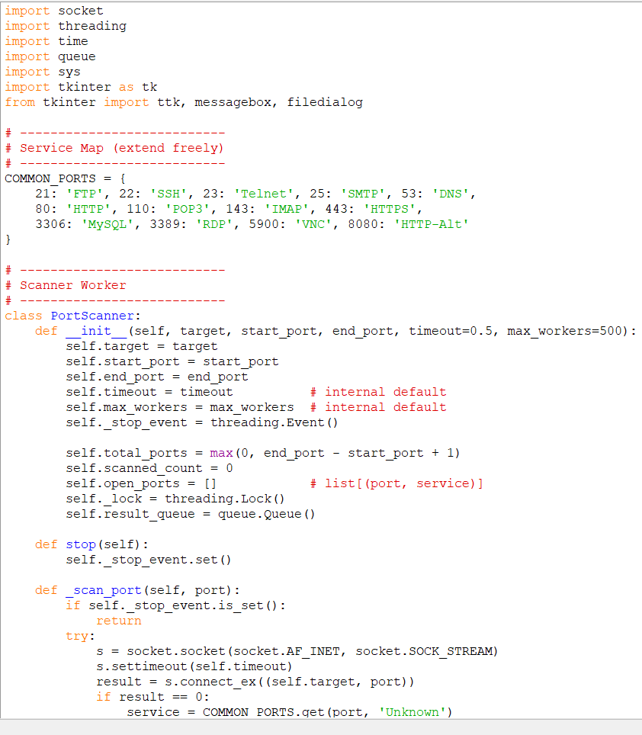
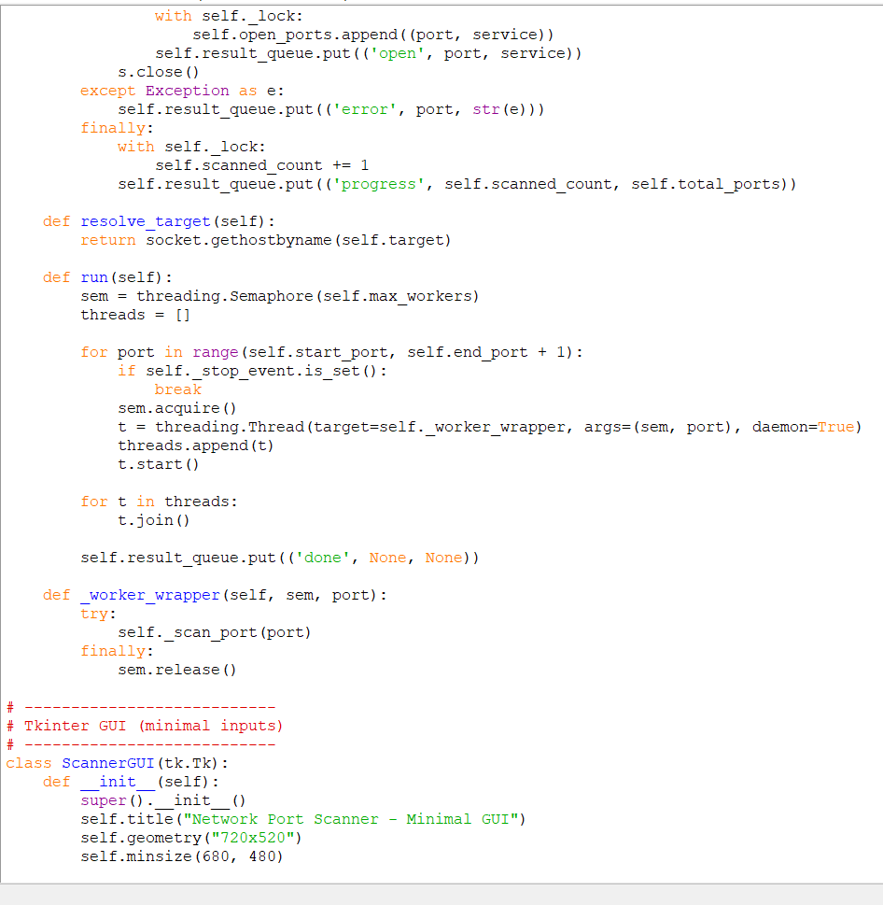
RESULTS
Demo link

Slide 7
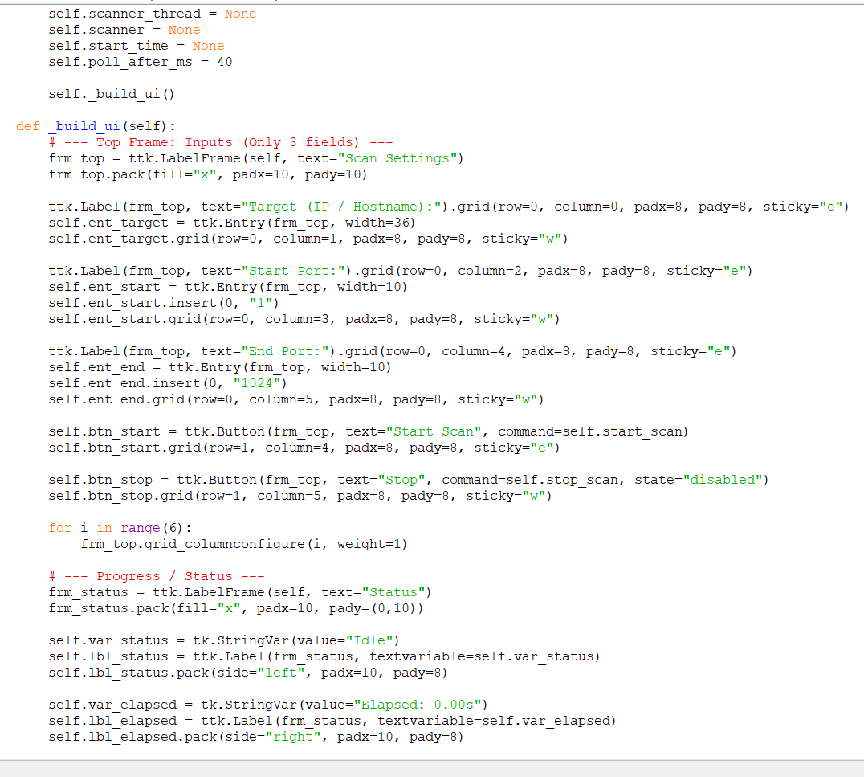
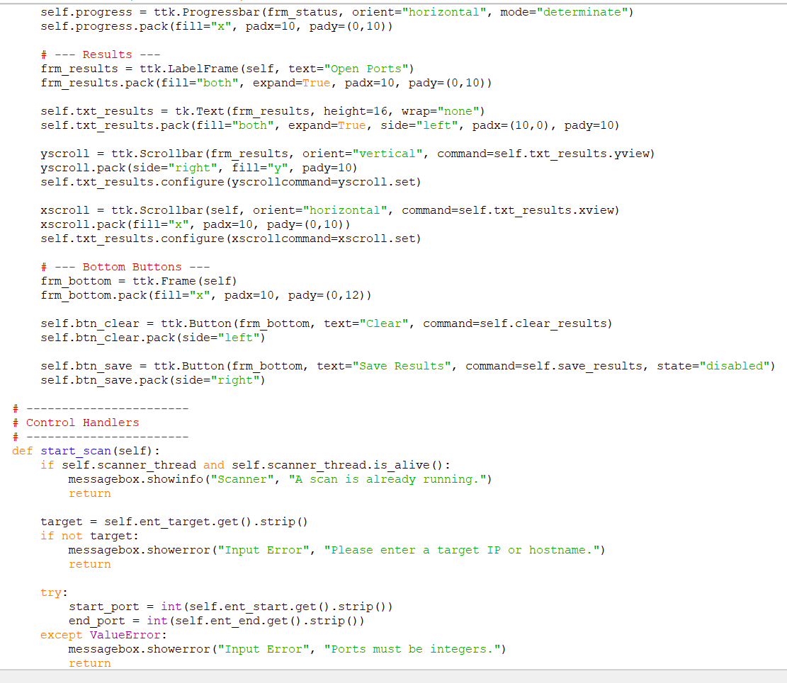
RESULTS
Demo link

Slide 8
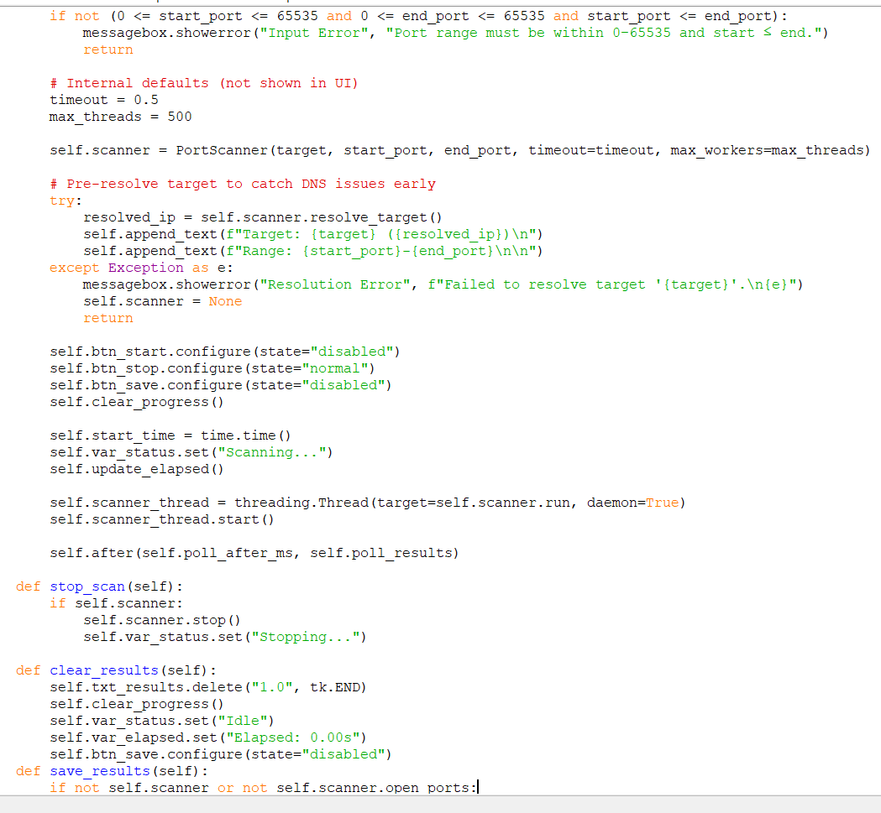
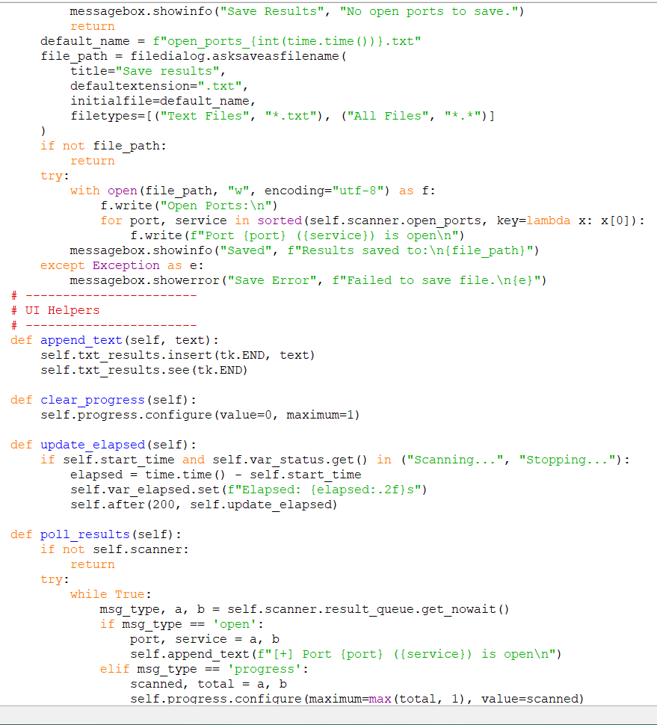
RESULTS

Slide 9
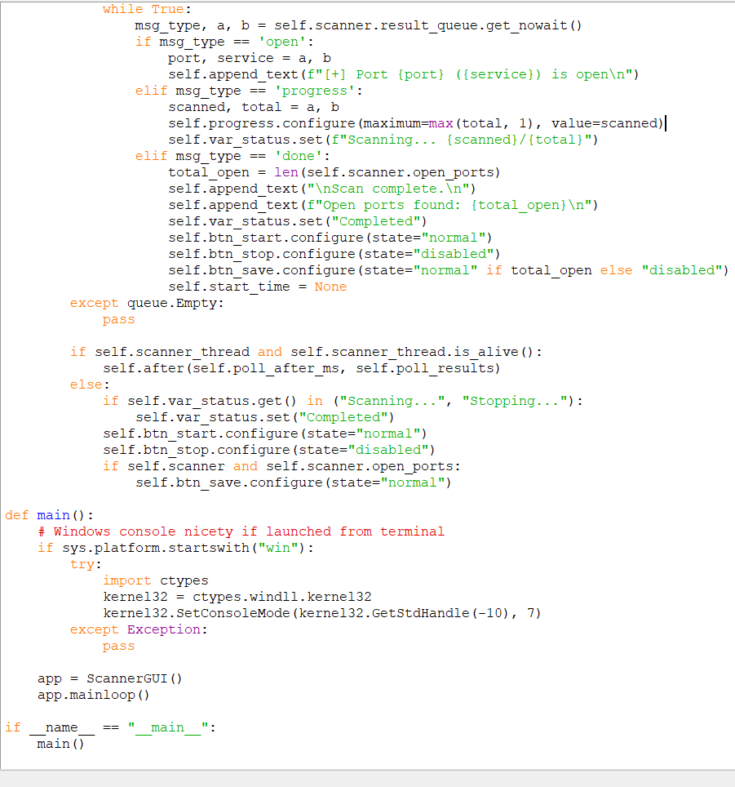
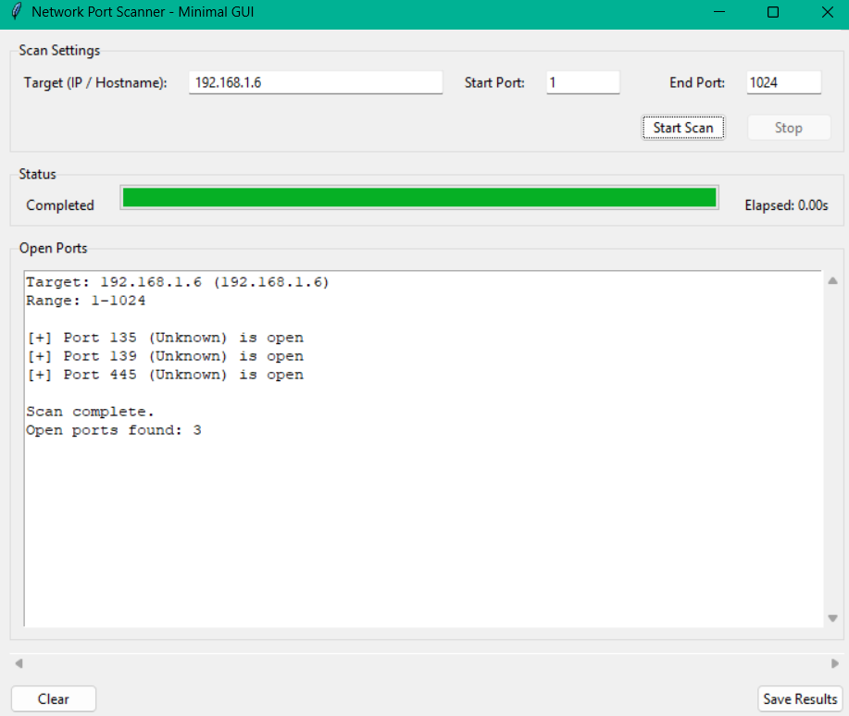
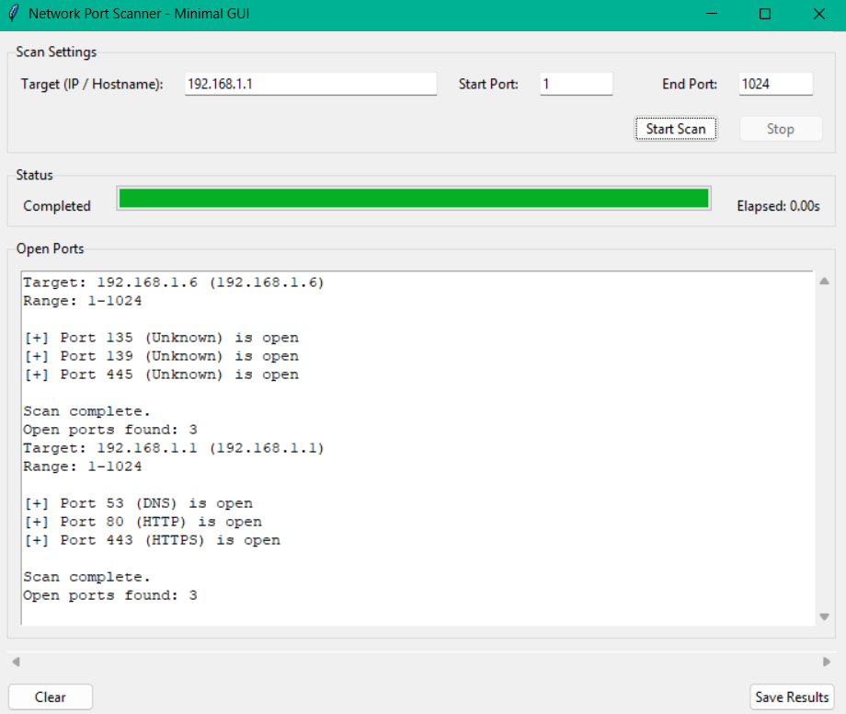
RESULTS
OUTPUT:

Slide 10
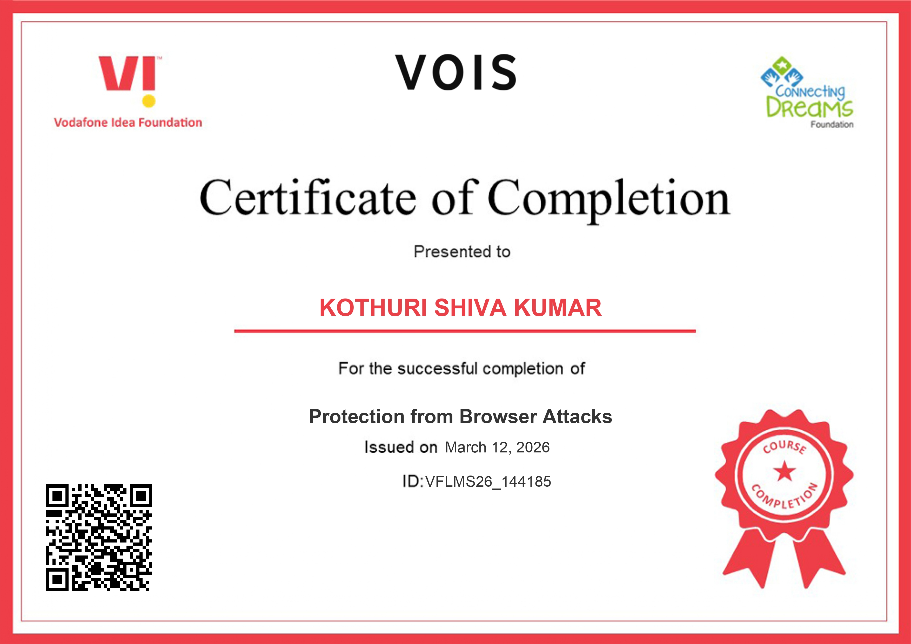
Certificate - Protection from browser attacks

Slide 11

Certificate - Introduction to System Security

Slide 12

GitHub link
Click This Logo To Get Project Link :

Slide 13
THANK YOU
.
.

